Slide 1
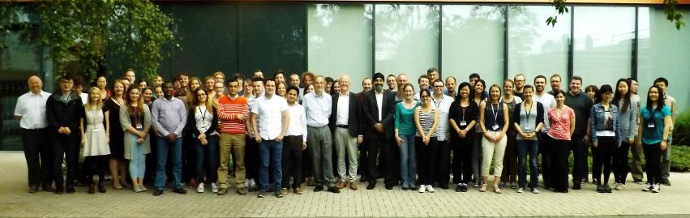
Green Chemistry and HSP
Towards an intelligent approach to solvent substitution
James Clark and James Sherwood
Green Chemistry Centre of Excellence, University of York, UK
Green Chemistry @ York
The world’s leading Centre for Green and Sustainable
research, training and commercialisation

Slide 2


Green Chemistry at York: from research bench to semi-scale
Speculative
Research
Focussed Research
Applied Research
Industrial Collaboration
Discovery
Green Chemistry Centre
Commercial Products
Ideas
Biorenewables Development Centre
Environmental Impact Assessments
Scale-up & Application Studies
Laboratory & Desk-top Studies
Training for industry partners
Proving routes & technologies
Green Chemistry has to work!!!
Notes:
2

Slide 3
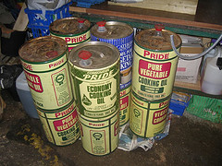
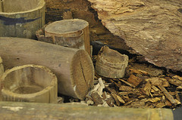

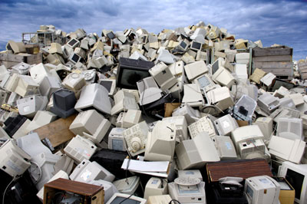
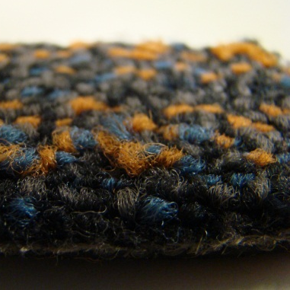
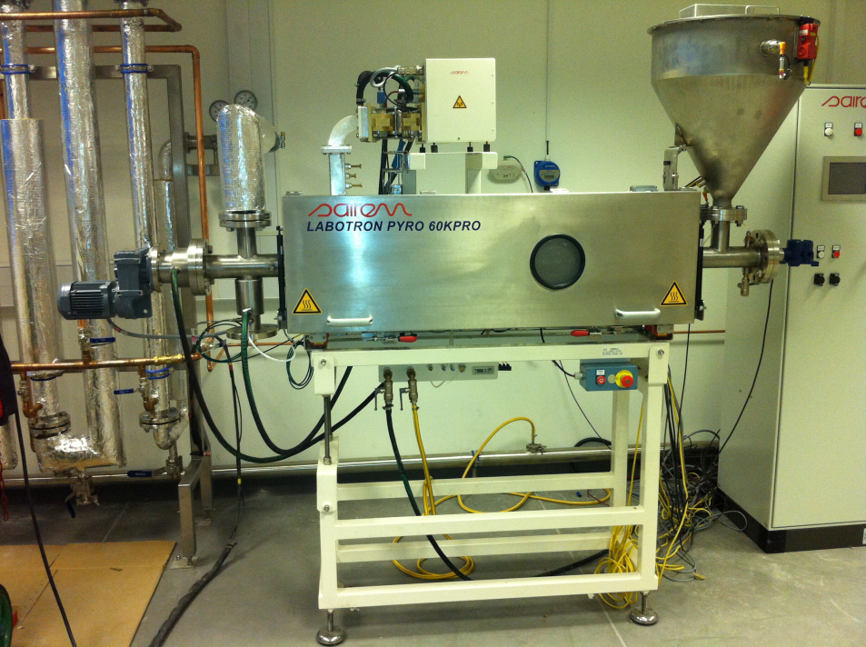
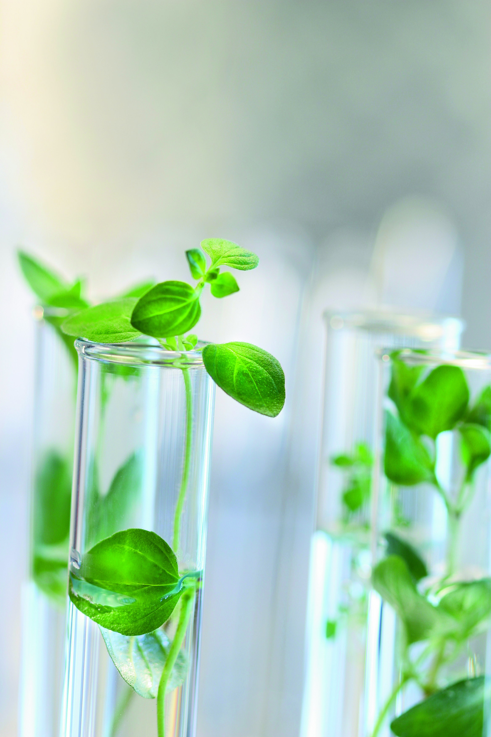
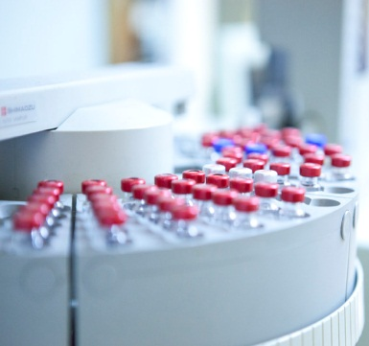

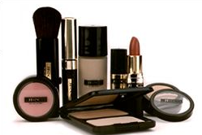
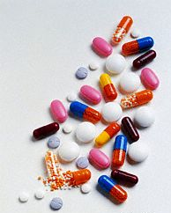


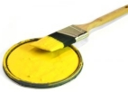
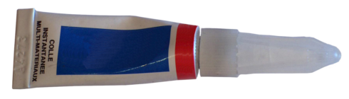
Our Technology Platforms
Renewable Resources and Materials
Microwave Chemistry and Processing
Natural and Bio-derived Solvents
From waste to wealth using Green Chemistry
Clean Synthesis and Platform Molecules
And… Carbon Dioxide Chemistry

Slide 4



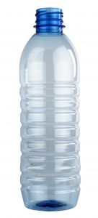



Benefits of the Chemical Industry
97% of all goods are manufactured
using at least one chemical reaction
But its not sustainable…..in products, process or resources….
Notes:
4
4

Slide 5
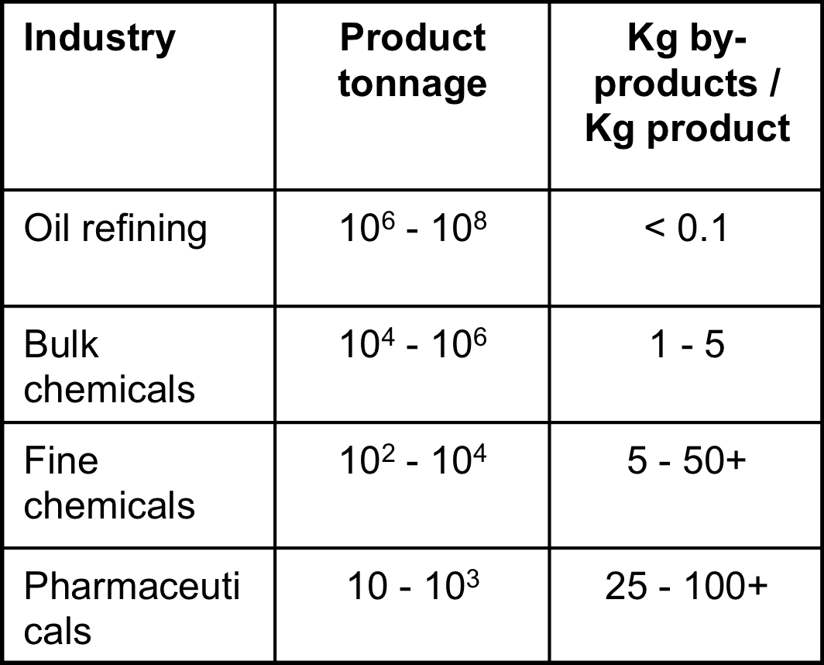
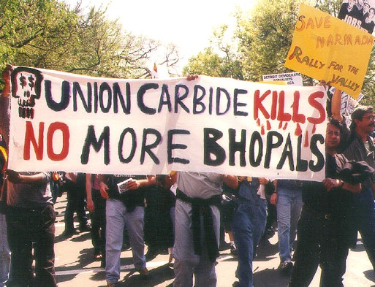
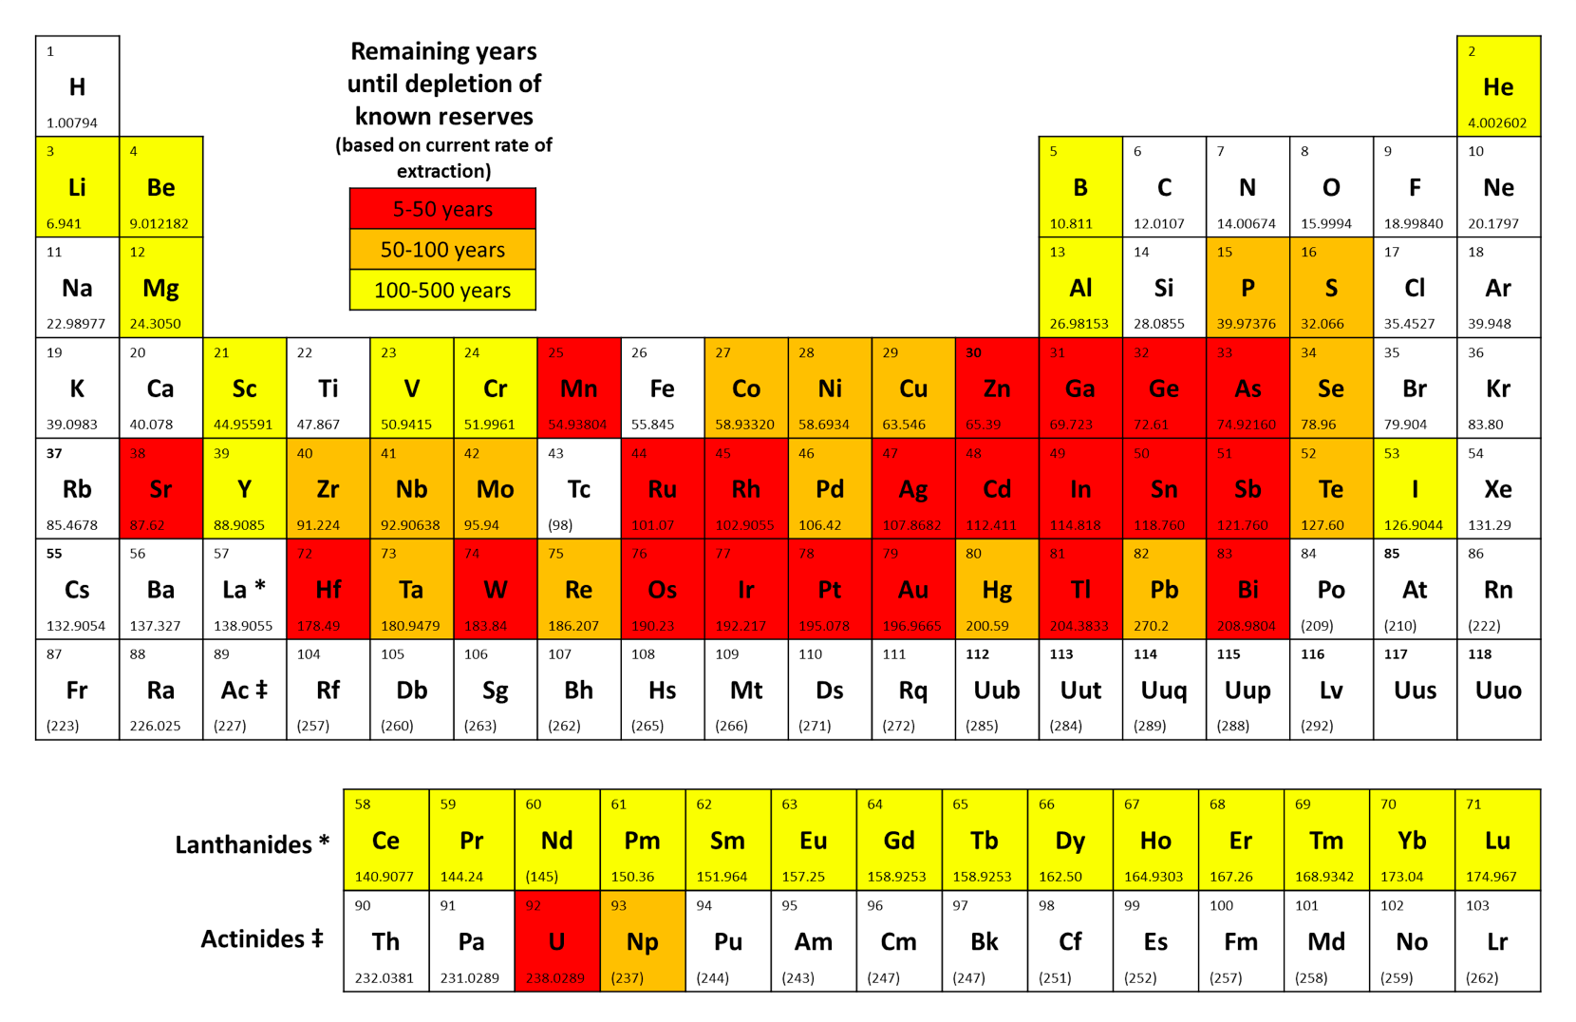
We are using non-renewable, diminishing resources.
Making more waste than product, and using dangerous substances
REACh!

Slide 6


We are heavily reliant on non-renewables......but our crude oil reserves are finite
> 90% of chemicals are manufactured from oil and gas
BUT time is running out for petrochemical feedstocks…and for other resources...

Slide 7
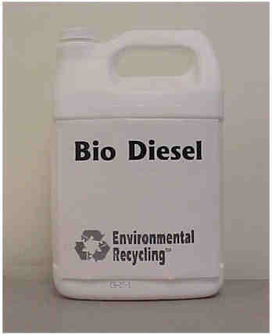
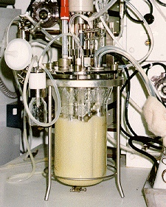
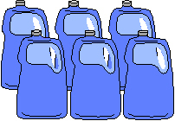

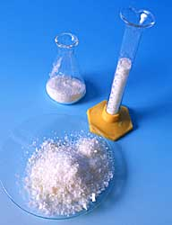
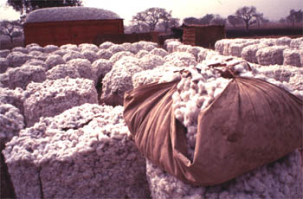
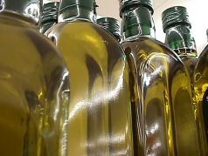
Bio-refinery
Fuels
Solvent
Plastics
Biomass
Bulk chemicals
Fine chemicals
Fibres
Oils
Don’t use food quality feedstocks!!

Slide 8
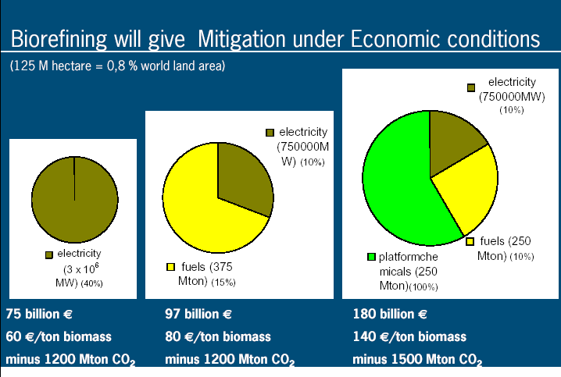
125 M hectare = 0.8% world land area
75 billion € 60€/ T of biomass 1200 Mt CO₂ savings
97 billion € 80€/ T of biomass 1200 Mt CO₂ savings
180 billion € 140€/ T of biomass 1500 Mt CO₂ savings
Biorefining will improve the process economics
(Energy -> Fuels -> Chemicals)
Johan Sanders - Wageningen University, The Netherlands Biorefinery,
the bridge between Agriculture and Chemistry

Slide 9


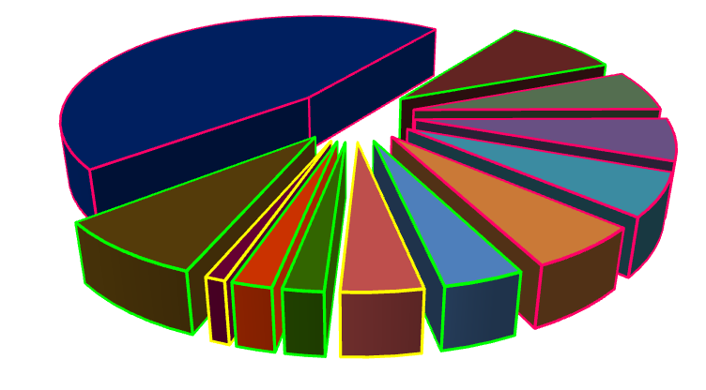
Solvent Market
Market: 20 Million
Tonnes /year
Solvent is needed in manufacturing & processing
Paints/coatings
Pharma
Inks
Adhesives
Home cleaning
Other industries
Cosmetics
Plastics industry
Agrochemicals
Metal cleaning
Dry cleaning
Food sector
Solvent used for washing
ESIG data, 1997

Slide 10
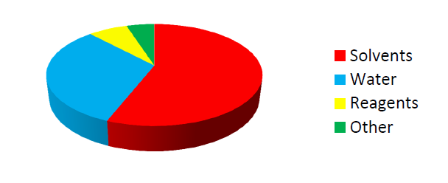
In Pharmaceutical Manufacturing
1 kg of API necessitates more than 100 kg of material
  Cleaning is not included!
Solvents and water represent ca 75% of these
  Reduce the impact by reduction of solvent & water amount
  Use the “greenest” solvents
Chem21 was set up to tackle such issues….
Chem21.eu

Slide 11
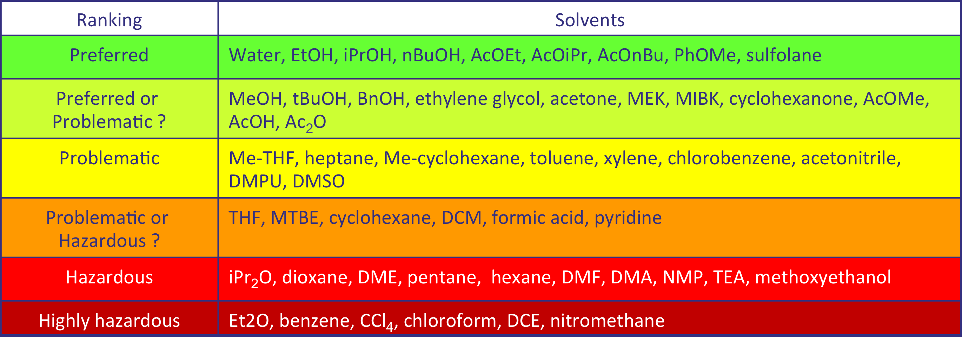



CHEM21 SOLVENT GUIDE
But existing solvents are not enough…
we need new, preferably bio-based solvents

Slide 12
REACH is making it worse….
Regulation (EC 1907/2006)
Substances of Very High Concern (SVHC)
An opportunity for bio-based solvents?
echa.europa.eu/regulations/reach/authorisation/the-candidate-list
echa.europa.eu/candidate-list-table
Notes:
The first step in the authorisation process is to identify those substances that may have serious effects on human health or the environment and, therefore, the risks resulting from their use must be properly controlled and the substances progressively replaced when possible.
A Member State or ECHA at the request of the European Commission, can propose a substance to be identified as a Substance of Very High Concern (SVHC). If identified, the substance is added to the Candidate List, which includes candidate substances for possible inclusion in the Authorisation List (Annex XIV).

Slide 13
Green chemistry and solvents
Solvent replacement
Green Chemistry Principle #5
The use of auxiliary substances (e.g., solvents, separation agents, etc.) should be made unnecessary wherever possible and, innocuous when used.
https://www.acs.org/content/acs/en/greenchemistry/what-is-green-chemistry/principles/12-principles-of-green-chemistry.html

Slide 14

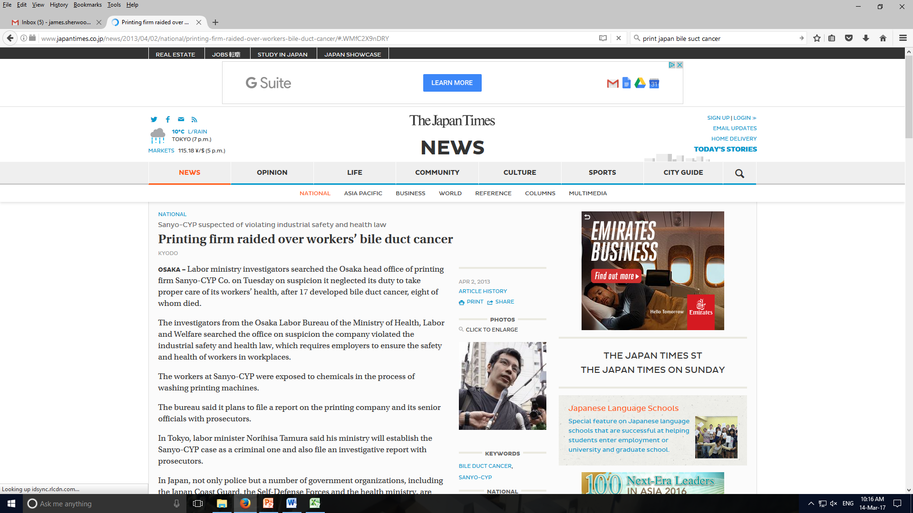
Green chemistry and solvents
The hazards
http://www.japantimes.co.jp/news/2013/04/02/national/printing-firm-raided-over-workers-bile-duct-cancer/#.WMfC2X9nDRY; http://www.bbc.co.uk/news/uk-scotland-tayside-central-35151700.

Slide 15
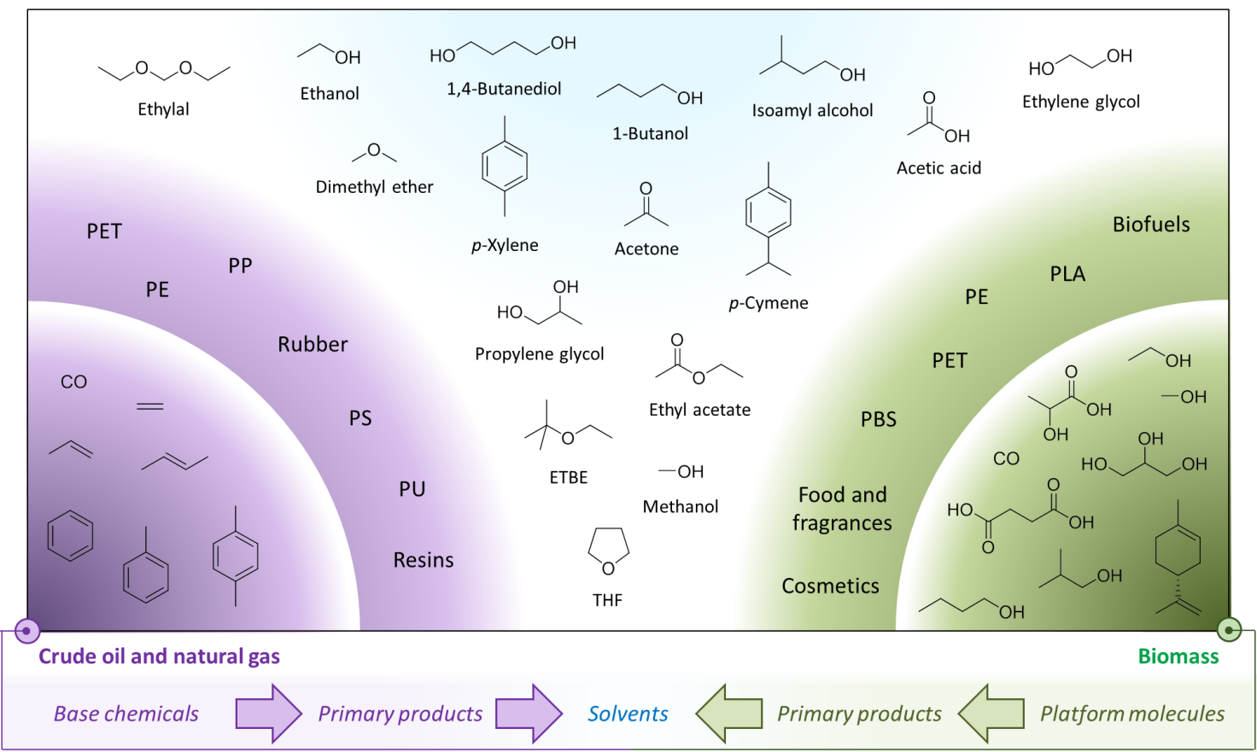
Green chemistry and solvents
The solution?
Bio-based solvents. Renewable, but equally toxic.
J. H. Clark et al., Int. J. Mol. Sci., 2015, 16, 17101.

Slide 16
Levoglucosenone
Opportunities for different solvents
Selective pyrolysis of biomass (e.g. sawdust) produces a new bio-based platform molecule.
G. R. Court et al., US Pat. 2012/0111714, 2012.

Slide 17
Levoglucosenone
Derivitisation
X=OH, Y=(CH₂)_{n} (ketalisation)
X=Y=H (hydrogenation)
X=OMe, Y=H (Michael addition)
X=OMe, Y=H (alcoholysis)
Cycloaddition also possible

Slide 18
Levoglucosenone
An intermediate for bio-based solvents
Dihydrolevoglucosenone (Cyrene™) is easily made by the hydrogenation of levoglucosenone.
J. Sherwood et al., Chem. Comm., 2014, 50, 9650.

Slide 19
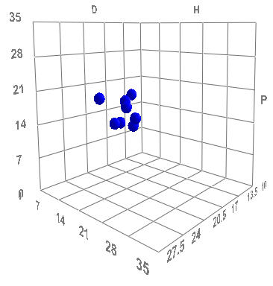
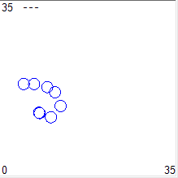
Cyrene™
Proof of concept using HSP
Cyrene
NMP
P
H
HSPiP, 5th edition, version 5.0.03, 2015.

Slide 20
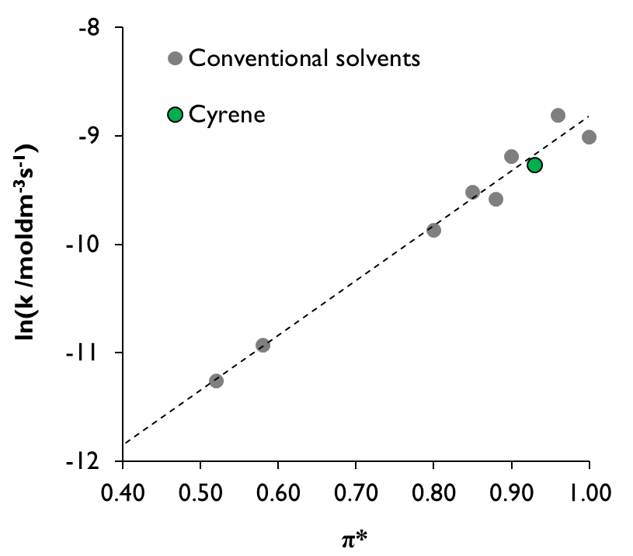
Cyrene™
Applications in synthesis
J. Sherwood et al., Chem. Comm., 2014, 50, 9650.

Slide 21
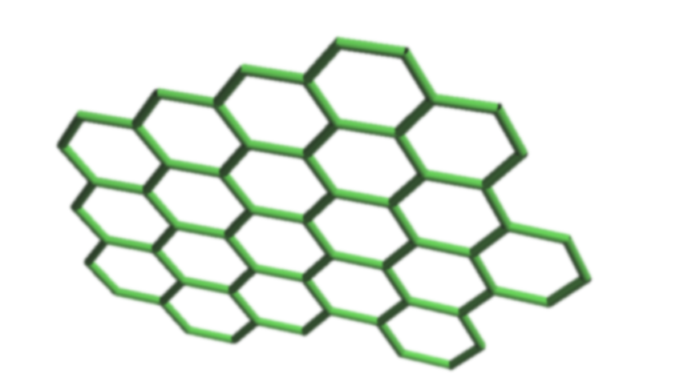
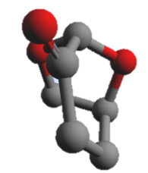
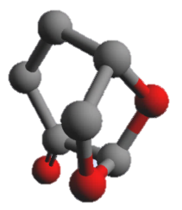
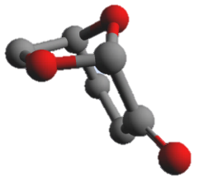
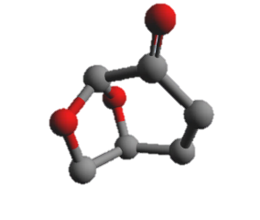
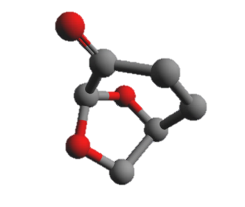
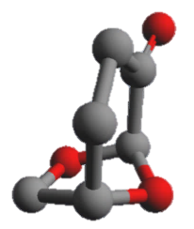
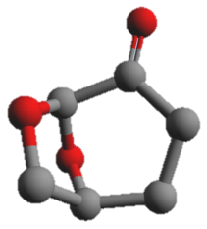

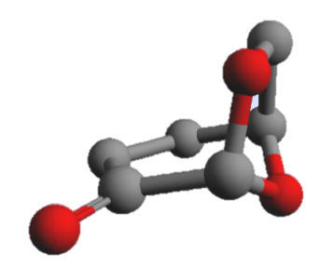
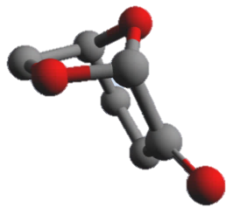
Cyrene™
Applications in materials

Slide 22
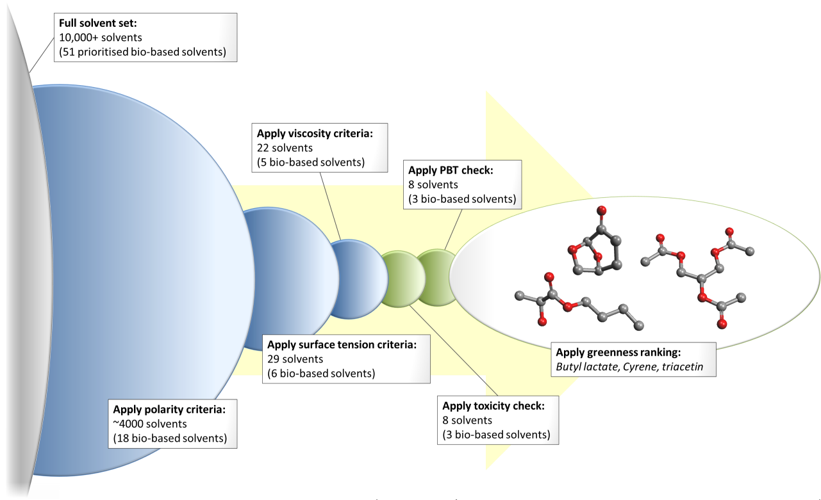
Cyrene™
Graphene dispersion: solvent selection
H.J. Salavagione et al., Green Chem., 2017, advanced article. DOI: 10.1039/C7GC00112F .

Slide 23
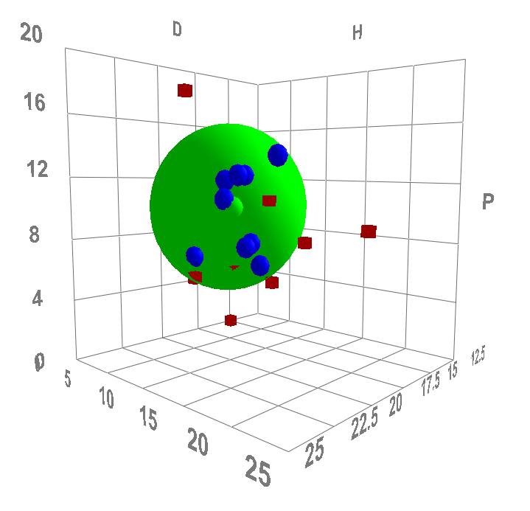
Cyrene™
Graphene dispersion: solvent selection
Phase 1: properties
HSPiP, 5th edition, version 5.0.03, 2015.

Slide 24
Cyrene™
Graphene dispersion: solvent selection
Priority bio-based solvents (51) …
… with the correct polarity (18) …
… and the right surface tension (6) …
… and a suitable viscosity (5) …

Slide 25



Cyrene™
Graphene dispersion: solvent selection
Phase 2: regulatory status
Level 1= REACH for restriction
  Carcinogenic or mutagenic or reprotoxic (CMR)
  Persistant and bio-accumulating and (eco)toxic (PBT)
Level 2 = GHS CLP for labelling
  Acute toxicity
  Environmental hazard
EU regulation (EC) No 1907/2006 for the Registration, Evaluation, Authorisation & restriction of CHemicals (REACH); European regulation (EC) 1272/2008 on classification, labelling and packaging of substances and mixtures (CLP).

Slide 26
Cyrene™
Graphene dispersion: solvent selection
Bio-based solvents with the required performance characteristics:
Butyl lactate
Cyrene™
Furfural
Tetrahydrofurfuryl alcohol
Triacetin
These petrochemical solvents also pass:
1,2-Dichlorobenzene
Benzonitrile
Cyclohexanone
Cyclopentanone
Pyridine

Slide 27
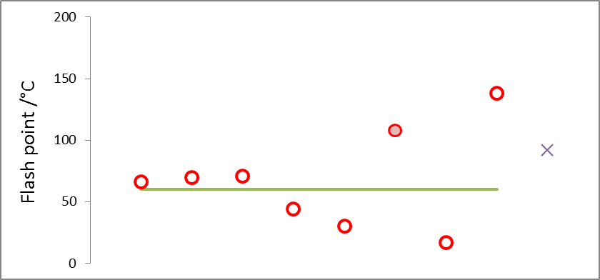
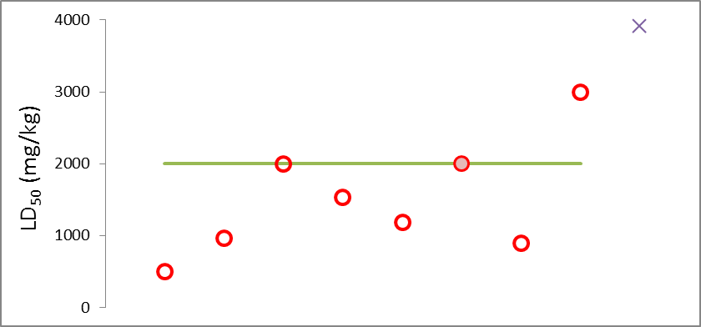
Cyrene™
Graphene dispersion: solvent selection
Phase 3: green metrics
1,2-Dichlorobenzene
Benzonitrile
Butyl lactate
Cyclohexanone
Cyclopentanone
Cyrene™
Pyridine
Triacetin
NMP

Slide 28
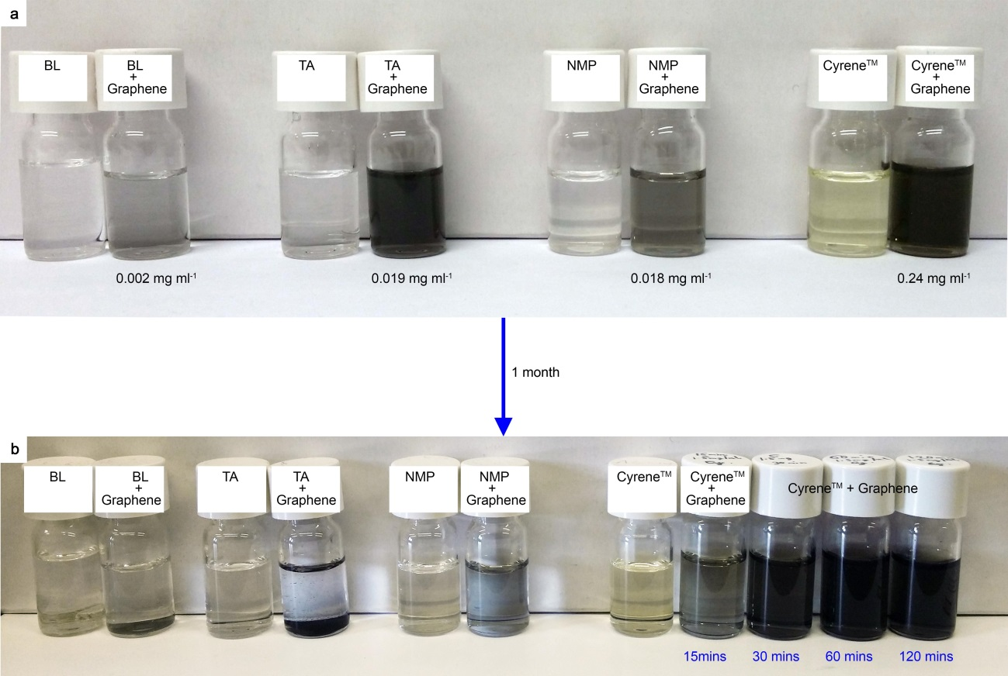
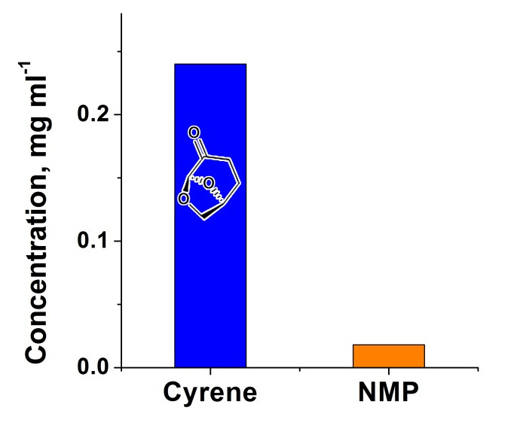
Cyrene™
Graphene dispersion: results
H.J. Salavagione et al., Green Chem., 2017, advanced article. DOI: 10.1039/C7GC00112F .

Slide 29
Cyrene™
Graphene dispersion: results
TEM analysis of Cyrene dispersed graphene.
A holey carbon grid coated with a number of graphene flakes.
A single graphene flake.
The border area of the flake in (b), magnified.
A larger single graphene flake and a smaller flake underneath.

Slide 30
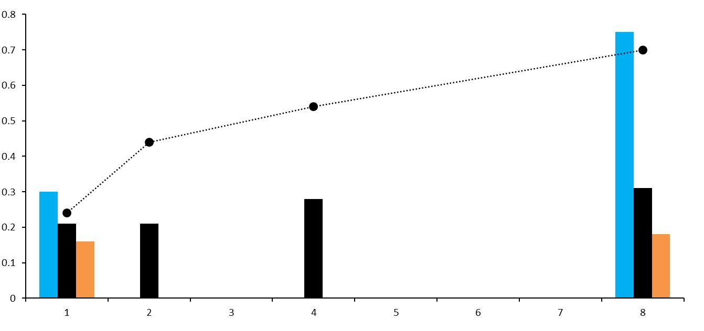
Cyrene™
Graphene dispersion: results
NMP
Cyrene™
Triacetin
15 30 45 60 120
Dots: Graphene concentration in Cyrene™ (mg/mL)
Bars: A_{D}/A_{G} (Raman spectroscopic analysis)
As a function of time /minutes

Slide 31
Cygnet
Another levoglucosenone solvent
‘Easy’ derivatives of Cyrene™ offer different solvent opportunities
A. Alves Costa Pacheco et al., ChemSusChem, 2016, 9, 3503.

Slide 32
Cygnet
Screening levoglucosenone derivatives
Screening the literature:
Derivatives of levoglucosenone published 1995-2015.
Melting point <100 °C.
Add derivatives: saturated olefins, esters and ethers.
HSP target = DCM
  Level 1: R_{a} = 3.0 MPa^{½}
  Level 2: R_{a} = 1.2 MPa^{½}
HSP target = NMP
  Level 1: R_{a} = 3.0 MPa^{½}
  Level 2: R_{a} = 2.4 MPa^{½}
96
164
53
15
21
15

Slide 33
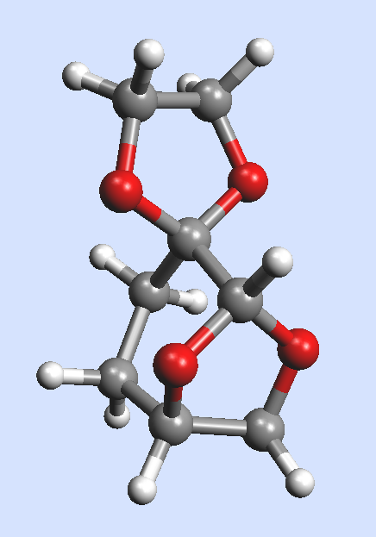
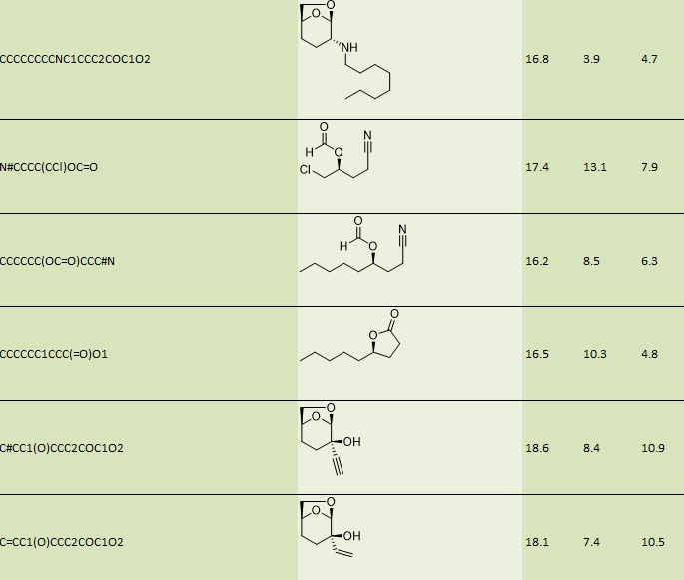


Cygnet
Screening levoglucosenone derivatives

Slide 34

Cygnet
Matching targets with HSP

Slide 35

Cygnet
Applications in synthesis
Log(initial rate)
Low boiling solvents
Hydrocarbons
Water
Oxygentated solvents
N/S dipolar aprotics

Slide 36






York, the University of York and the Green Chemistry Centre of Excellence

Slide 37

The global picture: the bio-economy is priority worldwide

Slide 38



G2C2 MEMBERS
2013: 8 Centres 2014: 21 Centres 2015: 31 Centres 2016: 33 Centres

Slide 39
The latest GCCE initiative…....
RenewChem
Promoting sustainable chemical manufacturing
through the use of bio-resources and green chemistry
Industry Club
and
Centre for Graduate Training

Slide 40

Industry
Education
www.greenchemistry.net
Research
Networking

